Slide 1
BFX AT-100 RMA TOP FAILURE REPORT
Model Name BFX AT-100
Quantity | 1728pcs
Date | 11/04/2024
MO | 2645000324
Prepare by: PE – Luc
Date: 2024/05/14

Slide 2
BFX AT-100 RMA Top Issue Overview
Failure Symptom | Failure Q'TY | D/R
Boot up fail: Can't download Factory FW + short 3.3V | 87 | 4.46%
Download Factory FW stop (7%) | 63 | 3.65%
Boot up fail: Short R324 (1.8V) | 6 | 0.35%
HDMI functions test fail | 4 | 0.23%
Product boot up fail: auto reset | 4 | 0.23%
Product can't PING | 4 | 0.23%
Led Light up pink | 1 | 0.06%
Download Factory FW stop (9%) | 1 | 0.06%
Product can't PING | 1 | 0.06%
Total D/R | 171 | 9.90%
The D/R of this model is 9.90% (171/1728pcs RMA-T99X171.00)
TOP 1&2 failure symptom = 87.72% of total FR of this model
2/N

Slide 3

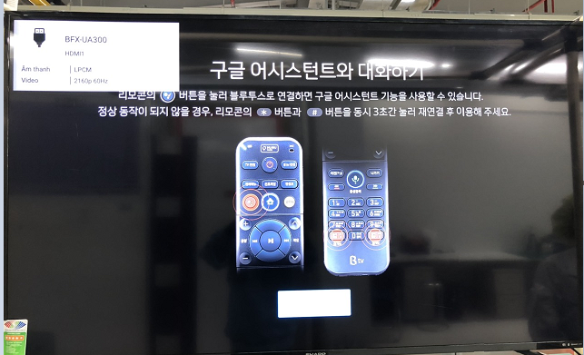
TOP1: Can’t download Factory FW .D/R: 5.03%
Issue Description (5W2H) |  | Root Cause | Action | Owner | Status
When | 2024/April | Fail status: Product boot up fail. Root cause: Case1: Voltage measurement did not detect abnormalities. Follow SoC (U1), Emmc (U602), Re-test PASS Case2: 3.3V/ VDDCPU short to GND Follow SoC (U1), Emmc (U602), U1101, U1001, U801,U305 no short to GND. | Repair Action: - RE receive material for repair Emmc U602 and SoC U1 on the board. Improve action: Send FA report + NG material to SQE sent to AMLOGIC vendor further analysis. Duedate: 30/06 Material name: U1-SoC P/N: 002.02753.005 DC:2214,2212,,2206,2313,… Vendor: AMLOGIC | - PE:Luc - RD: Jerry/ Rex Huang - Customer: ALT | Monitor
Who | ALT customer
Where | SK networks warehouse, Anseong, Korea.
What | ALT customer feedback that they found out 87/1728pcs~5.03% RMA has boot up fail.
Why | Case1: Boot up fail, Voltage measurement did not detect abnormalities*4.46% Case 2: Boot up fail due to 3.3V/ VDDCPU short to GND*0.58%
How much /many | D/R: 87/1728 = 5.03%~50347DDM
How Often | This issue follow U1-SoC (P/N: 002.02753.005. Vendor: AMLOGIC).
NG
No display signal
OK
OK display signal
3/N

Slide 4
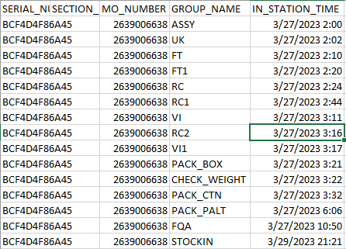
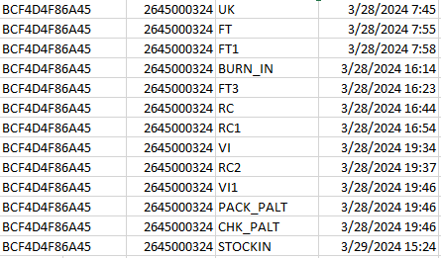
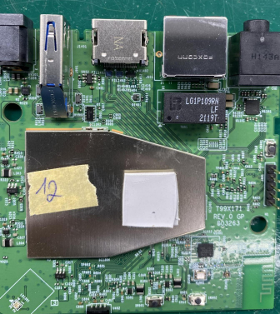
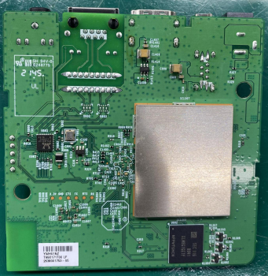
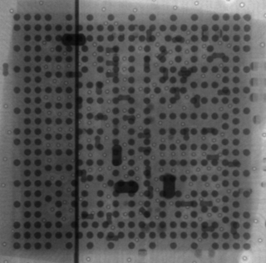
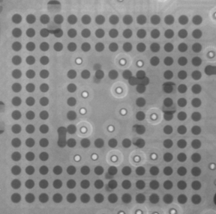
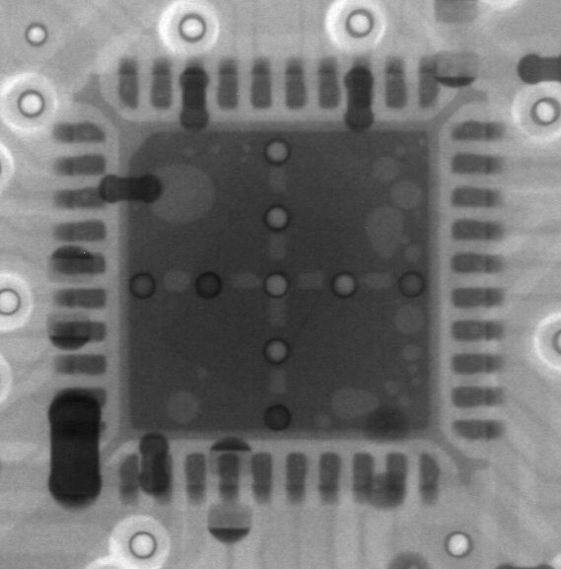
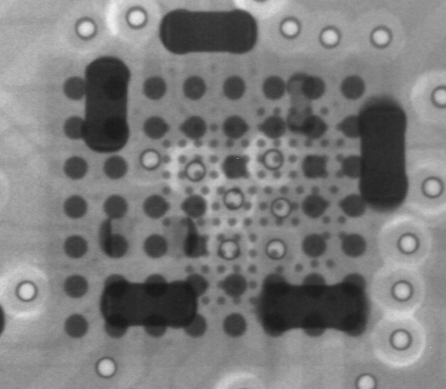
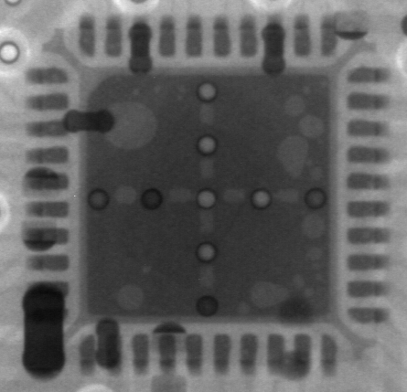
System Level Checking
Board level -1
No# | Item check | Image reference | Result | Remark
1 | Recheck Boot up at OBA station |  | Fail | NG units boot up fail
2 | Recheck record production data |  | Normal | Normal FATP Pass check Function
3 | Visual inspection |  | Normal | No process effecting to failure
4 | X-Ray focus on SoC, U801, U1101, U1001, eMMC location |  | Normal
Boot Up Fail
SoC
eMMC
U1101
U1001
U801
Summary: - Recheck Boot up 5/5pcs NG → Boot up fail
- Recheck production data, VI, X-ray are OK
"Listens to customers, Meet customer expectation"

Slide 5
TOP 1 Issue: Measurement
Case 1: Boot up fail, Voltage measurement did not detect
Board level -2
Measure impedance and VF NG1 + NG2 +NG3 units, received result as table below:
Measure impedance & VF voltage NG1 + NG2 Units
Location | Description | NG1 sample |  | NG2 sample |  | NG3 sample |  | OK sample
 |  | Impedance | VF | Impedance | VF | Impedance | VF | Impedance | VF
R328 | PP_PWR_IN | 3.33K | 0.503 | 3.313K | 0.506 | 3.046k | 0.5 | 3.260K | 0.504
L303 | P1V2 | 169.5 | 0.084 | 169.9 | 0.084 | 191.1 | 0.092 | 182 | 0.089
R325 | P2V5 | 21.37K | 0.390 | 21.69K | 0.393 | 18.45K | 0.363 | 21.61K | 0.392
L304 | P3V3 | 2.723k | 0.33 | 2.741K | 0.346 | 2.73K | 0.348 | 19.59K | 0.348
C322 | eMMC_VDDQ | 22.53k | 0.432 | 23.25K | 0.41 | 23.14K | 0.416 | 23.14K | 0.416
L301 | VDDCPU | 61.9 | 0.071 | 56.3 | 0.061 | 88.7 | 0.085 | 66.1 | 0.075
L302 | VDD_EE | 16.3 | 0.015 | 21.2 | 0.020 | 25.2 | 0.023 | 35.5 | 0.037
L801 | ETH_DVDD10 | 1.823k | 0.311 | 1.821K | 0.294 | 1.952K | 0.287 | 1.952K | 0.299
Summary:
- Measure impedance and VF NG1 + NG2 +NG3 units → Found out impedance abnormal on L304 (P3V3).
"Listens to customers, Meet customer expectation"

Slide 6
TOP 1 Issue: Measurement
Component level -3
Measure impedance: Remove U602 and measure impedance result as table below:
Pin# | Description | NG 1 | NG 2 | NG 3 | OK Sample
 |  | Impedance | Impedance | Impedance | Impedance
A3 | DAT0 | NA | NA | NA | NA
A4 | DAT1 | NA | NA | NA | NA
A5 | DAT2 | NA | NA | NA | NA
B2 | DAT3 | 1.357M | 1.408M | 1.342M | 1.405M
B3 | DAT4 | 18.28K | 20.34K | 19.45K | 20.61K
B4 | DAT5 | NA | NA | NA | NA
B5 | DAT6 | NA | NA | NA | NA
B6 | DAT7 | NA | NA | NA | NA
K5 | RSTN | 1.702M | 1.711M | 1.668M | 1.53M
C6 | VDD | NA | NA | NA | NA
M4 | VDD | NA | NA | NA | NA
N4 | VDD | NA | NA | NA | NA
P3 | VDD | NA | NA | NA | NA
P5 | VDD | NA | NA | NA | NA
E6 | VDDF | 27.37M | 26.25M | 25.6M | 26.25M
F5 | VDDF | 27.73 | 28.4 | 26.95 | 25.5M
J10 | VDDF | 28.4 | 27.8 | 26.6 | 20.8M
K9 | VDDF | 26.2 | 26.6 | 26.8 | 25.3M
C2 | VDDI | 1.081M | 1.413M | 1.371M | 1.391M
M5 | CMD | NA | NA | NA | NA
Pin# | Description | NG 1 | NG2 | NG3 | OK Sample
 |  | Impedance | Impedance | Impedance | Impedance
H5 | Data Strobe | NA | NA | NA | NA
M6 | CLK | NA | NA | NA | NA
J5 | VSS | NA | NA | NA | NA
A6 | VSS | NA | NA | NA | NA
C4 | VSS | NA | NA | NA | NA
E7 | VSS | 93.6 | 99.6 | 97.7 | 117
G5 | VSS | 94.2 | 99.6 | 98.2 | 114
H10 | VSS | 91.5 | 96.1 | 92.2 | 109.8
K8 | VSS | NA | NA | NA | NA
N2 | VSS | NA | NA | NA | NA
N5 | VSS | NA | NA | NA | NA
P4 | VSS | NA | NA | NA | NA
P6 | VSS | NA | NA | NA | NA
Summary: After measure impedance U602, no found out abnormal.
"Listens to customers, Meet customer expectation"

Slide 7
TOP1 Issue: Measurement
Component level -4
Measure impedance: Remove U1 and measure impedance result as table below:
NO# | Pin# | Description | NG 1 | NG 2 | NG 3 | OK Sample
 |  |  | Impedance | Impedance | Impedance | Impedance
1 | J32 | AVDD18_PCIe | 196.3M | 230K | 228K | 225K
2 | L29 | AVDD33_USB | 89.2K | 7.83 | 0.942M | 0.931M
3 | L31 | VDDIO_H | 30 | 32 | 27 | 38
4 | L33 | AVDD18_ENET | 1.495M | 1.62M | 1.495M | 1.525M
5 | L35 | AVDD18_USB | 346.5 | 10.73K | 1345M | 1. 353M
6 | G14 | VDDQ | 1.7M | 1.94M | 58.7K | 32.3K
7 | G29 | VDDIO_AO | 40.1K | 42.2K | 40.6K | 37.3K
8 | N31 | AVDD18_AUDIO | 0.967M | 1.075M | 0.853M | 0.908M
9 | N33 | AVDD18_HDMI | 1.592M | 1.471M | 1.466M | 1.426M
10 | P13 | VDDQ | 11.25K | 11.12K | 10.82K | 10.11K
11 | P15 | VDDQ | 11.25K | 11.12K | 10.82K | 10.10K
12 | J14 | VDDQ | 11.28K | 11.85K | 9.88K | 10.26K
13 | J29 | VDDIO_C | 41.1 | 40.3 | 41.3 | 40.4
14 | R26 | AVDD0V8_USB_PCIe | 21.2 | 0.941K | 5.901K | 3.972K
15 | R28 | AVDD0V8_HDM | 1.046K | 28.87K | 29.54K | 28.84K
16 | R31 | AVDD18_AO | 1.252M | 1.17M | 1.076M | 1.14M
17 | R33 | AVDD18_CVBS | 0.679M | 1.42M | 1.323M | 1.379M
18 | AA23 | AVDD18_AO | 0.781M | 1.158M | 1.065M | 1.167M
19 | AG20 | VDDCPU | 44.4 | 42.8 | 50.2 | 48.5
20 | AG26 | VDD_EE | 11 | 29 | 29.9 | 27.2
21 | U15 | VDDQ | 58.5K | 56k | 74.2K | 69K
22 | U17 | VDD_EE | 11.1 | 28 | 29.6 | 25
23 | AC15 | AVDD_DDRPLL | 0.785M | 0.703M | 0.696M | 0.656M
24 | AJ15 | VDDQ | 11.72K | 11.09K | 10.76K | 10.49K
NO# | Pin# | Description | NG 1 | NG2 | NG3 | OK Sample
 |  |  | Impedance | Impedance | Impedance | Impedance
25 | U26 | VDD_EE | 11.2 | 34.7 | 34.9 | 31.5
39 | AJ20 | VDDCPU | 45.3 | 47.8 | 49.4 | 43.5
27 | AJ23 | VDDCPU | 45.3 | 47.6 | 49.5 | 43.5
28 | AJ26 | VDD_EE | 10.8 | 27.1 | 28.3 | 25.7
29 | AJ29 | VDD_EE | 10.8 | 28.4 | 28.9 | 26.2
30 | AJ31 | VDDAO_0V8 | 0.823M | 1.17K | 1.366K | 0.953K
31 | AJ39 | AVDD18_AO | 0.988M | 1.11M | 1.013M | 1.082M
32 | AE26 | VDD_EE | 10.9 | 29 | 29.2 | 26.7
33 | AL20 | VDDCPU | 45.1 | 47.9 | 50.3 | 44.7
34 | AL23 | VDDCPU | 45 | 48 | 50.2 | 44.8
35 | Y15 | VDDQ | 54.8K | 72.1K | 55.5K | 70.4K
36 | AF15 | VDDQ | 54.2K | 70.6K | 54.4K | 69.4K
37 | AF17 | VDD_EE | 10.7 | 27.7 | 28.4 | 25.9
38 | AF29 | VDD_EE | 10.9 | 27.7 | 28.4 | 25.8
39 | AF31 | VDD_EE | 10.7 | 27.5 | 28.3 | 25.8
40 | AM31 | VDD_EE | 26.8 | 13.3 | 37.8 | 40.7
41 | AU26 | VDDCPU | 48.6 | 49.4 | 50.3 | 44.7
42 | AV37 | VDDIO_X | 2.63M | 2.51M | 2.668M | 2.54M
43 | AV39 | VDDIO_Z | 3.41M | 3.45M | 3.520M | 3.47M
44 | AN23 | VDDCPU | 2.8M | 3.17M | 3.09M | 3.16M
45 | AW20 | VDDIO_BOOT | 3.540M | 3.18M | 3.108M | 3.03M
46 | AW26 | VDDCPU | 54.8 | 61 | 64.8 | 58.2
47 | AR26 | VDDCPU | 55.8 | 60.8 | 64.9 | 53.4
Summary: After measure impedance U1, found out some pins abnormal which highlighted by red letter.
"Listens to customers, Meet customer expectation"

Slide 8
TOP1 Issue: Swap verification
Component level -5
Swap verification between OK and NG U1+U602 material and retest all functions + OBA test, result as table below:
Swap verification | NG1 | NG2 | NG3
NG board + OK (U1+ U602) | OK | OK | OK
NG board + NG (U1+U602) | NG | NG | NG
OK board + NG (U1+U602) | NG | NG | NG
NG board + OK (U1+U602) | OK | OK | OK
Summary:
As analysis above this issue follow U1 (P/N: 002.02753.005) component.
Because SoC(U1) and Emmc(U602) need the same group, when the construction of secure is completed<Download FW success>. Some SoC-related information will be written into the special configuration area of Emmc to prevent it from being changed.
For example the RPMB region in Emmc
So when replace U1, you must replace U602 (P/N: 067.00140.005) component.
"Listens to customers, Meet customer expectation"

Slide 9
TOP1 Issue: Measurement
Case 2: Boot up fail due to 3.3V/ VDDCPU short to GND
Board level -1
Measure impedance and VF NG4 + NG5 + NG6 units, received result as table below:
Measure impedance & VF voltage NG1 + NG2 + NG3 Units
Location | Description | NG1 sample |  | NG2 sample |  | NG3 sample |  | OK sample
 |  | Impedance | VF | Impedance | VF | Impedance | VF | Impedance | VF
R328 | PP_PWR_IN | 3.33K | 0.503 | 3.313K | 0.506 | 3.046k | 0.5 | 3.260K | 0.504
L303 | P1V2 | 169.5 | 0.084 | 169.9 | 0.084 | 191.1 | 0.092 | 182 | 0.089
R325 | P2V5 | 21.37K | 0.390 | 21.69K | 0.393 | 18.45K | 0.363 | 21.61K | 0.392
L304 | P3V3 | 0.6 | 0.001 | 1.0 | 0.001 | 0.5 | 0.001 | 19.59K | 0.348
C322 | eMMC_VDDQ | 3.5 | 0.003 | 2.5 | 0.003 | 8.2 | 0.007 | 23.14K | 0.416
L301 | VDDCPU | 61.9 | 0.071 | 56.3 | 0.061 | 88.7 | 0.085 | 66.1 | 0.075
L302 | VDD_EE | 16.3 | 0.015 | 21.2 | 0.020 | 25.2 | 0.023 | 35.5 | 0.037
L801 | ETH_DVDD10 | 0.8 | 0.001 | 0.8 | 0.001 | 0.7 | 0.001 | 1.952K | 0.299
Summary:
- Measure impedance and VF NG4 + NG5 + NG6 units → Found out abnormal on C322 (eMMC_VDDQ), L304 (P3V3) and L801 (ETH_DVDD10) – short with GND
"Listens to customers, Meet customer expectation"

Slide 10
TOP1 Issue: Remove IC chip and measure impedance
Board level -2
Remove IC chip U1-SoC and measure impedance P3V3 on board:
Step | Remove location | Measure P3V3 | Result
1 | L304 | 0.6 ohm | Still Short GND
2 | U801 | 0.6 ohm | Still Short GND
3 | U1101 | 0.6 ohm | Still Short GND
4 | U1001 | 0.6 ohm | Still Short GND
5 | U602 | 3.5 ohm | Still Short GND
6 | U1(SoC) | 2.597M ohm | OK <No short>
DC/DC
U305
L304
U1101
R1014
U801
L53
P3V3
U1001
R1014
U602
R607
VDDIO_AO
U1
G29
Summary:
- This issue follow U1-SoC (Boot up fail due to 3.3V/ VDDCPU short to GND follow U1 (P/N: 002.02753.005) component.)
Notes:
5.26891E-07 4.96855E-07

Slide 11
TOP1 Issue: Measurement
Component level -1
Measure impedance: Remove U801 and measure impedance result as table below:
Pin# | Description | NG 4 | NG 5 | NG 6 | OK Sample
 |  | Impedance | Impedance | Impedance | Impedance
1 | MDIP0 | 16.4 | 90.2 | 2.2 | 1.050m
2 | MDIP0 | 2.6 | 1.2 | 36.3 | 1.050m
3 | AVDD10 | 12.5K | 5.6 | 3.3 | 13.2k
4 | MDIP1 | 1.050M | 1.282M | 1.246M | 1.036m
5 | MDIP1 | 1.049M | 1.282M | 1.246M | 1.04m
6 | MDIP2 | 1.036M | 1.313M | 1.250M | 1.041m
7 | MDIP2 | 1.037M | 1.329M | 1.250M | 1.043m
8 | AVDD10 | 12.5K | 5.3 | 3.0 | 13.22k
9 | MDIP3 | 3.162K | 1.313M | 0.837K | 1.035m
10 | MDIP3 | 464.8 | 1.313M | 1.0 | 1.034m
11 | AVDD33 | 2.4 | 2.8 | 1.2 | 117.8k
12 | PHYRSTB | 2.672M | 2.748M | 154.6 | 2.58m
13 | MDC | 2.647M | 2.732M | 2.709M | 2.55m
14 | MDIO | 2.652M | 2.732M | 2.715M | 2.55m
15 | TXD3 | 2.637M | 2.746M | 2.718M | 2.55m
16 | TXD2 | 2.691M | 2.718M | 2.715M | 2.56m
17 | TXD1 | 2.680M | 2.737M | 2.727M | 2.56m
18 | TXD0 | 2.675M | 2.726M | 2.723M | 2.57m
19 | TXCTL | 2.692M | 2.740M | 2.718M | 2.57m
20 | TXC | 2.673M | 2.754M | 2.722M | 2.56m
Pin# | Description | NG 4 | NG5 | NG6 | OK Sample
 |  | Impedance | Impedance | Impedance | Impedance
21 | AVDD10 | 14.7 | 9.7 | 187.3 | 2.29k
22 | RXD3/PHYAD0 | 2.567M | 2.670M | 2.632M | 2.46m
23 | RXD2/PLLOFF | 2.568M | 2.667M | 2.633M | 2.47m
24 | RXD1/RXDLY | 2.567M | 2.675M | 2.623M | 2.48m
25 | RXD0/RAXDLY | 2.565M | 2.665M | 2.613M | 2.46m
26 | RXCTL/PHYAD2 | 2.575M | 2.672M | 2.616M | 2.49m
27 | RXC/PHYAD1 | 2.579M | 2.665M | 2.639M | 2.48m
28 | DVDD_RG | 8.1 | 79.2 | 50.8 | 238.6k
29 | AVDD33 | 5.6 | 4.3 | 3.2 | 168.3k
30 | REG_OUT/LDO_OUT | 0.8 | 0.7 | 0.7 | 0.899m
31 | INTB/PMEB | 2.645M | 2.712M | 2.695M | 2.56m
32 | U8010/CFG_EXT | 2.674M | 2.753M | 2.713M | 2.56m
33 | U8011/CFG_LDO0 | 2.696M | 2.729M | 2.705M | 2.58m
34 | U8012/CFG_LDO1 | 2.475M | 2.742M | 2.706M | 2.58m
35 | CLKOUT | 2.675M | 2.777M | 2.754M | 2.57m
36 | XTAL_IN | 2.584M | 2.682M | 2.658M | 2.5m
37 | XTAL_OUT/EXT_CLK | 2.591M | 2.677M | 2.671M | 2.51m
38 | AVDD10 | 17.02K | 19.27K | 17.66K | 18.03k
39 | RSET | 2.805M | 2.832M | 2.780M | 2.65m
40 | AVDD33 | 2.6 | 3.1 | 1.0 | 117.6k
Summary: Measure impedance and VF U801, found out some pins abnormal, which highlighted by red letter.
"Listens to customers, Meet customer expectation"

Slide 12
TOP1 Issue: Measurement
Component level -2
Measure impedance: Remove U602 and measure impedance result as table below:
Pin# | Description | NG 4 | NG 5 | NG 6 | OK Sample
 |  | Impedance | Impedance | Impedance | Impedance
A3 | DAT0 | NA | NA | NA | NA
A4 | DAT1 | NA | NA | NA | NA
A5 | DAT2 | NA | NA | NA | NA
B2 | DAT3 | 1.205M | 1.658M | 1.599M | 1.117M
B3 | DAT4 | 20.05K | 19.6K | 19.89K | 26.3K
B4 | DAT5 | NA | NA | NA | NA
B5 | DAT6 | NA | NA | NA | NA
B6 | DAT7 | NA | NA | NA | NA
K5 | RSTN | 1.702M | 1.711M | 1.668M | 1.53M
C6 | VDD | NA | NA | NA | NA
M4 | VDD | NA | NA | NA | NA
N4 | VDD | NA | NA | NA | NA
P3 | VDD | NA | NA | NA | NA
P5 | VDD | NA | NA | NA | NA
E6 | VDDF | 9.2 | 11.3 | 25.6 | 2.292M
F5 | VDDF | 8.8 | 11.2 | 25.1 | 2.299M
J10 | VDDF | 8.7 | 11.2 | 24.5 | 2.3M
K9 | VDDF | 8.8 | 11.2 | 24.6 | 2.299M
C2 | VDDI | 1.656M | 1.668M | 1.601M | 1.468M
M5 | CMD | NA | NA | NA | NA
Pin# | Description | NG 4 | NG5 | NG6 | OK Sample
 |  | Impedance | Impedance | Impedance | Impedance
H5 | Data Strobe | NA | NA | NA | NA
M6 | CLK | NA | NA | NA | NA
J5 | VSS | NA | NA | NA | NA
A6 | VSS | NA | NA | NA | NA
C4 | VSS | NA | NA | NA | NA
E7 | VSS | 0.4 | 0.3 | 0.6 | NA
G5 | VSS | 0.4 | 0.4 | 0.5 | NA
H10 | VSS | 0.6 | 0.3 | 0.3 | NA
K8 | VSS | NA | NA | NA | NA
N2 | VSS | NA | NA | NA | NA
N5 | VSS | NA | NA | NA | NA
P4 | VSS | NA | NA | NA | NA
P6 | VSS | NA | NA | NA | NA
Summary: Measure impedance U602, found out some pins abnormal, which highlighted by red letter.
"Listens to customers, Meet customer expectation"

Slide 13
TOP1 Issue : Measurement
Component level -3
Measure impedance: Remove U1 and measure impedance result as table below:
NO# | Pin# | Description | NG 4 | NG 5 | NG 6 | OK Sample
 |  |  | Impedance | Impedance | Impedance | Impedance
1 | J32 | AVDD18_PCIe | 199K | 0.559M | 187.3K | 188.2K
2 | L29 | AVDD33_USB | 1.5 | 6.6 | 1.070K | 0.889M
3 | L31 | VDDIO_H | 5.1 | 34.5 | 5.0 | 6.37M
4 | L33 | AVDD18_ENET | 1.340M | 1.443M | 1.208M | 1.255M
5 | L35 | AVDD18_USB | 1.390M | 3.335K | 2.0 | 1.293M
6 | G14 | VDDQ | 11.24K | 9.88K | 11.25K | 10.22K
7 | G29 | VDDIO_AO | 1.0 | 2.0 | 2.4 | 2.597M
8 | N31 | AVDD18_AUDIO | 0.967M | 1.075M | 0.853M | 0.908M
9 | N33 | AVDD18_HDMI | 1.492M | 1.613M | 1.368M | 1.429M
10 | P13 | VDDQ | 11.25K | 11.82K | 9.89K | 10.24K
11 | P15 | VDDQ | 11.25K | 11.82K | 9.89K | 10.24K
12 | J14 | VDDQ | 11.28K | 11.85K | 9.88K | 10.26K
13 | J29 | VDDIO_C | 4.8 | 4.5 | 3.9 | 5.99M
14 | R26 | AVDD0V8_USB_PCIe | 0.982K | 0.972K | 6.6 | 1.160K
15 | R28 | AVDD0V8_HDM | 17.16K | 13.56K | 109.7K | 107.4K
16 | R31 | AVDD18_AO | 0.806M | 65.4 | 10.4 | 0.797M
17 | R33 | AVDD18_CVBS | 0.679M | 0.773M | 0.557M | 0.609M
18 | AA23 | AVDD18_AO | 0.801M | 65.0 | 10.3 | 0.801M
19 | AG20 | VDDCPU | 56.2 | 49.9 | 77.6 | 78.5
20 | AG26 | VDD_EE | 26.7 | 13.5 | 38.2 | 39.7
21 | U15 | VDDQ | 11.29K | 11.82k | 9.9k | 10.26K
22 | U17 | VDD_EE | 26.3 | 35.6 | 38.4 | 39.3
23 | AC15 | AVDD_DDRPLL | 0.743M | 0.8M | 0.621M | 0.656M
24 | AJ15 | VDDQ | 11.26K | 11.84K | 9.90K | 10.23K
NO# | Pin# | Description | NG 4 | NG5 | NG6 | OK Sample
 |  |  | Impedance | Impedance | Impedance | Impedance
25 | U26 | VDD_EE | 26.3 | 14.3 | 29.2 | 39.2
39 | AJ20 | VDDCPU | 55.7 | 50.1 | 77.4 | 77.7
27 | AJ23 | VDDCPU | 55.6 | 50.2 | 77.8 | 76.9
28 | AJ26 | VDD_EE | 26.3 | 13.6 | 0.2 | 38.7
29 | AJ29 | VDD_EE | 26.3 | 13.8 | 38.2 | 38.6
30 | AJ31 | VDDAO_0V8 | 39.1 | 0.977K | 1.816K | 1.968K
31 | AJ39 | AVDD18_AO | 0.799M | 64.9 | 10.2 | 0.791M
32 | AE26 | VDD_EE | 26 | 12.6 | 38.2 | 38.7
33 | AL20 | VDDCPU | 57.1 | 49.7 | 77.4 | 79.7
34 | AL23 | VDDCPU | 57.6 | 49.9 | 77.2 | 80.2
35 | Y15 | VDDQ | 1.682M | 11.79K | 9.88K | 1.975M
36 | AF15 | VDDQ | 1.706M | 11.76K | 9.87K | 2.011M
37 | AF17 | VDD_EE | 1.682M | 13.9 | 38.5 | 1.983M
38 | AF29 | VDD_EE | 27.1 | 13.7 | 38.4 | 40.3
39 | AF31 | VDD_EE | 27.0 | 13.5 | 38.4 | 40.2
40 | AM31 | VDD_EE | 26.8 | 13.3 | 37.8 | 40.7
41 | AU26 | VDDCPU | 57.1 | 55.6 | 55.8 | 80.3
42 | AV37 | VDDIO_X | 1.0 | 2.5 | 2.2 | 1.845M
43 | AV39 | VDDIO_Z | 3.592M | 2.189M | 3.610M | 3.094M
44 | AN23 | VDDCPU | 3.530M | 3.128M | 3.208M | 3.23M
45 | AW20 | VDDIO_BOOT | 3.540M | 3.637M | 2.106M | 2.886M
46 | AW26 | VDDCPU | 56.7 | 58.6 | 60.8 | 65.2
47 | AR26 | VDDCPU | 56.8 | 55.5 | 65.8 | 72.4
Summary: Measure impedance U1, found out some pins abnormal, which highlighted by red letter.
"Listens to customers, Meet customer expectation"

Slide 14
TOP1 Issue: Swap verification
Component level -4
Swap verification between OK and NG U1, U602 material and retest all functions + OBA test, result as table below:
Swap verification | NG4 | NG5 | NG6
OK board + OK (U1+U602) | OK | OK | OK
NG board + NG (U1+U602) | NG | NG | NG
OK board + NG (U1+U602) | NG | NG | NG
NG board + OK (U1+U602) | OK | OK | OK
Summary: As analysis above boot up fail due to 3.3V/ VDDCPU short to GND follow U1 (P/N: 002.02753.005) component. So when replace U1, you must replace U602 (P/N: 067.00140.005) component.
"Listens to customers, Meet customer expectation"

Slide 15
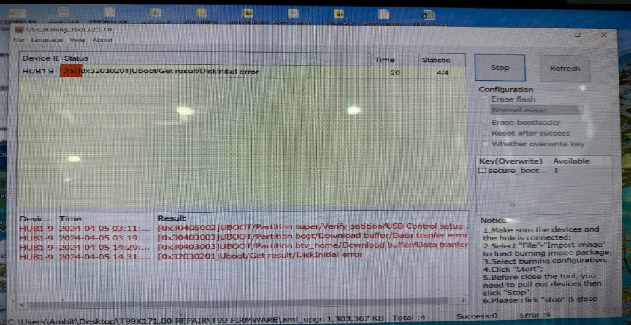
TOP 2 Issue: Download Factory FW stop 7%.D/R: 3.70%
Issue Description (5W2H) |  | Root Cause | Action | Owner | Status
When | 2024/April | Fail status: Download FW stop 7%. Root cause: This issue follow material: Emmc-U602 | Repair action: Change new Emmc <U602> can cover issue. Improve action: - Send FA report and NG material to vendor SAMSUNG for future analyzing. Material name: U602-eMMC P/N: 067.00140.005, Vendor: SAMSUNG. - SQE confirm with vendor Samsung will respond to failure analysis reports. Duedate: 31/05. | -PE: Luc/SQE: Naomi - RD: Jerry Rex Huang -Vendor: Samsung - Customer: ALT | Monitor
Who | ALT customer
Where | SK networks warehouse, Anseong, Korea.
What | ALT customer feedback that they found out 63/1728pcs pcs RMA has boot up fail.
Why | Product boot up fail and can't download Factory FW stop 7%
How much /many | UK 63/1728 = 3.65%~36458DDM
How Often | - This issue follow eMMC U602 (P/N: 067.00140.005, Vendor: SAMSUNG) material fail.
Download FW Stop 7%
15/N

Slide 16
TOP2 Issue: Measurement
Component level -1
Measure impedance and VF NG1 + NG2 +NG3 units, received result as table below:
Measure impedance & VF voltage NG1 + NG2 Units
Location | Description | NG1 sample |  | NG2 sample |  | NG3 sample |  | OK sample
 |  | Impedance | VF | Impedance | VF | Impedance | VF | Impedance | VF
R328 | PP_PWR_IN | 3.33K | 0.503 | 3.313K | 0.506 | 3.046k | 0.5 | 3.260K | 0.504
L303 | P1V2 | 169.5 | 0.084 | 169.9 | 0.084 | 191.1 | 0.092 | 182 | 0.089
R325 | P2V5 | 21.37K | 0.390 | 21.69K | 0.393 | 18.45K | 0.363 | 21.61K | 0.392
L304 | P3V3 | 2.723k | 0.33 | 2.741K | 0.346 | 19.59K | 0.348 | 19.59K | 0.348
C322 | eMMC_VDDQ | 22.53k | 0.432 | 23.25K | 0.41 | 23.14K | 0.416 | 23.14K | 0.416
L301 | VDDCPU | 61.9 | 0.071 | 56.3 | 0.061 | 88.7 | 0.085 | 66.1 | 0.075
L302 | VDD_EE | 16.3 | 0.015 | 21.2 | 0.020 | 25.2 | 0.023 | 35.5 | 0.037
L801 | ETH_DVDD10 | 1.823k | 0.311 | 1.821K | 0.294 | 1.952K | 0.287 | 1.952K | 0.299
Summary:
- Measure impedance and VF NG1 + NG2 +NG3 units → No found out abnormal
"Listens to customers, Meet customer expectation"

Slide 17
TOP 2 Issue: Measurement
Component level -2
Measure impedance: Remove U1 and measure impedance result as table below:
NO# | Pin# | Description | NG 1 | NG 2 | NG 3 | OK Sample
 |  |  | Impedance | Impedance | Impedance | Impedance
1 | J32 | AVDD18_PCIe | 196.3M | 230K | 228K | 225K
2 | L29 | AVDD33_USB | 0.922M | 0.912M | 0.942M | 0.931M
3 | L31 | VDDIO_H | 30 | 32 | 27 | 38
4 | L33 | AVDD18_ENET | 1.495M | 1.62M | 1.495M | 1.525M
5 | L35 | AVDD18_USB | 1.321M | 1.345K | 1.345M | 1. 353M
6 | G14 | VDDQ | 1.7M | 1.94M | 58.7K | 32.3K
7 | G29 | VDDIO_AO | 40.1K | 42.2K | 40.6K | 37.3K
8 | N31 | AVDD18_AUDIO | 0.967M | 1.075M | 0.853M | 0.908M
9 | N33 | AVDD18_HDMI | 1.592M | 1.471M | 1.466M | 1.426M
10 | P13 | VDDQ | 11.25K | 11.12K | 10.82K | 10.11K
11 | P15 | VDDQ | 11.25K | 11.12K | 10.82K | 10.10K
12 | J14 | VDDQ | 11.28K | 11.85K | 9.88K | 10.26K
13 | J29 | VDDIO_C | 41.1 | 40.3 | 41.3 | 40.4
14 | R26 | AVDD0V8_USB_PCIe | 4.232K | 3.941K | 4.301K | 3.972K
15 | R28 | AVDD0V8_HDM | 28.56K | 28.87K | 29.54K | 28.84K
16 | R31 | AVDD18_AO | 1.252M | 1.17M | 1.076M | 1.14M
17 | R33 | AVDD18_CVBS | 1.413M | 1.42M | 1.323M | 1.379M
18 | AA23 | AVDD18_AO | 0.781M | 1.158M | 1.065M | 1.167M
19 | AG20 | VDDCPU | 44.4 | 42.8 | 50.2 | 48.5
20 | AG26 | VDD_EE | 11 | 29 | 29.9 | 27.2
21 | U15 | VDDQ | 58.5K | 56k | 74.2K | 69K
22 | U17 | VDD_EE | 11.1 | 28 | 29.6 | 25
23 | AC15 | AVDD_DDRPLL | 0.785M | 0.703M | 0.696M | 0.656M
24 | AJ15 | VDDQ | 11.72K | 11.09K | 10.76K | 10.49K
NO# | Pin# | Description | NG 1 | NG2 | NG3 | OK Sample
 |  |  | Impedance | Impedance | Impedance | Impedance
25 | U26 | VDD_EE | 34.2 | 34.7 | 34.9 | 31.5
39 | AJ20 | VDDCPU | 45.3 | 47.8 | 49.4 | 43.5
27 | AJ23 | VDDCPU | 45.3 | 47.6 | 49.5 | 43.5
28 | AJ26 | VDD_EE | 27.8 | 27.1 | 28.3 | 25.7
29 | AJ29 | VDD_EE | 28.8 | 28.4 | 28.9 | 26.2
30 | AJ31 | VDDAO_0V8 | 0.823M | 1.17K | 1.366K | 0.953K
31 | AJ39 | AVDD18_AO | 0.988M | 1.11M | 1.013M | 1.082M
32 | AE26 | VDD_EE | 10.9 | 29 | 29.2 | 26.7
33 | AL20 | VDDCPU | 45.1 | 47.9 | 50.3 | 44.7
34 | AL23 | VDDCPU | 45 | 48 | 50.2 | 44.8
35 | Y15 | VDDQ | 54.8K | 72.1K | 55.5K | 70.4K
36 | AF15 | VDDQ | 54.2K | 70.6K | 54.4K | 69.4K
37 | AF17 | VDD_EE | 27.7 | 27.7 | 28.4 | 25.9
38 | AF29 | VDD_EE | 10.9 | 27.7 | 28.4 | 25.8
39 | AF31 | VDD_EE | 10.7 | 27.5 | 28.3 | 25.8
40 | AM31 | VDD_EE | 26.8 | 13.3 | 37.8 | 40.7
41 | AU26 | VDDCPU | 48.6 | 49.4 | 50.3 | 44.7
42 | AV37 | VDDIO_X | 2.63M | 2.51M | 2.668M | 2.54M
43 | AV39 | VDDIO_Z | 3.41M | 3.45M | 3.520M | 3.47M
44 | AN23 | VDDCPU | 2.8M | 3.17M | 3.09M | 3.16M
45 | AW20 | VDDIO_BOOT | 3.540M | 3.18M | 3.108M | 3.03M
46 | AW26 | VDDCPU | 54.8 | 61 | 64.8 | 58.2
47 | AR26 | VDDCPU | 55.8 | 60.8 | 64.9 | 53.4
Summary: Measure impedance U1 no found out abnormal.
,
"Listens to customers, Meet customer expectation"

Slide 18
TOP 2 Issue: Measurement
Component level -3
Measure impedance: Remove U602 and measure impedance result as table below:
Pin# | Description | NG 1 | NG 2 | NG 3 | OK Sample
 |  | Impedance | Impedance | Impedance | Impedance
A3 | DAT0 | NA | NA | NA | NA
A4 | DAT1 | NA | NA | NA | NA
A5 | DAT2 | NA | NA | NA | NA
B2 | DAT3 | 1.635M | 1.607M | 1.522M | 1.433M
B3 | DAT4 | 18.74K | 17.80K | 16.31K | 25.78K
B4 | DAT5 | NA | NA | NA | NA
B5 | DAT6 | NA | NA | NA | NA
B6 | DAT7 | NA | NA | NA | NA
K5 | RSTN | 1.637M | 1.606M | 1.512M | 1.516M
C6 | VDD | NA | NA | NA | NA
M4 | VDD | NA | NA | NA | NA
N4 | VDD | NA | NA | NA | NA
P3 | VDD | NA | NA | NA | NA
P5 | VDD | NA | NA | NA | NA
E6 | VDDF | 2.339M | 2.326M | 2.327M | 2.266M
F5 | VDDF | 2.340M | 2.326M | 2.328M | 2.262M
J10 | VDDF | 2.335M | 2.224M | 2.294M | 2.261M
K9 | VDDF | 2.323M | 2.328M | 2.328M | 2.299M
C2 | VDDI | 1.615M | 1.608M | 1.521M | 1.460M
M5 | CMD | NA | NA | NA | NA
Pin# | Description | NG 1 | NG2 | NG3 | OK Sample
 |  | Impedance | Impedance | Impedance | Impedance
H5 | Data Strobe | NA | NA | NA | NA
M6 | CLK | NA | NA | NA | NA
J5 | VSS | NA | NA | NA | NA
A6 | VSS | NA | NA | NA | NA
C4 | VSS | NA | NA | NA | NA
E7 | VSS | 0.3 | 0.2 | 0.2 | 0.2
G5 | VSS | 0.2 | 0.42 | 0.3 | 0.2
H10 | VSS | 0.2 | 0.3 | 0.3 | 0.3
K8 | VSS | NA | NA | NA | NA
N2 | VSS | NA | NA | NA | NA
N5 | VSS | NA | NA | NA | NA
P4 | VSS | NA | NA | NA | NA
P6 | VSS | NA | NA | NA | NA
Summary: Measure impedance U602 no found out abnormal.
"Listens to customers, Meet customer expectation"

Slide 19
TOP 2 Issue: Swap verification
Component level -4
Swap verification between OK and NG U602 material and retest all functions + OBA test, result as table below:
Swap verification | NG1 | NG2 | NG3
OK board + OK U602 | OK | OK | OK
NG board + NG U602 | NG | NG | NG
OK board + NG U602 | NG | NG | NG
NG board + OK U602 | OK | OK | OK
Summary: As analysis above this issue follow flash: U602 (P/N: 002.02152.005, vendor: SAMSUNG) component.
"Listens to customers, Meet customer expectation"

Slide 20
Conclusion
1. The RMA-BFT AT100 Customer return 1728pcs failure include:
Top 1 failure: Boot up fail: Can't download Factory FW + 3.3V/VDDCPU short to GND is 87/1728pcs ~ 5.03%
Top 2 failure : Download Factory FW stop (7%) is 63/1728pcs ~ 3.65%
2. Repair Action:
Top 1 issue:
Change SoC: U1 P/N: 002.02753.005 Vendor: AMLOGIC, 87pcs~5.03%
Flash eMMC: U602, PN: P/N: 067.00140.005, Vendor: SAMSUNG, 87pcs~5.03%
Top 2 issue:
Change Flash: U602, PN: P/N: 067.00140.005, Vendor: SAMSUNG, 63pcs~3.65%
"Listens to customers, Meet customer expectation"

